Slide 1
Big Data Final Project By: Gal Ben yosef & Andrey Permyakov 326813581 200835999

Slide 2
Table of content
Introduction.................................. 1-3
Messing around with R...................... 4-8
Predicting with Poisson regression........ 9-18
Predictions sample.......................... 19-26

Slide 3
Goal
The goal here is to use available data to to say something about how many goals a team is expected to score and from that calculate the probabilities for different match outcomes.

Slide 4
Data preparation
http://www.football-data.co.uk/data.php
Data columns before touch-up :
Div Date HomeTeam AwayTeam FTHG FTAG FTR HTHG HTAG HTR Referee HS AS HST AST HF AF HC AC HY AY HR AR B365H B365D B365A BWH BWD BWA IWH IWD IWA LBH LBD LBA PSH PSD PSA WHH WHD WHA VCH VCD VCA Bb1X2 BbMxH BbAvH BbMxD BbAvD BbMxA BbAvA BbOU BbMx>2.5 BbAv>2.5 BbMx<2.5 BbAv<2.5 BbAH BbAHh BbMxAHH BbAvAHH BbMxAHA BbAvAHA PSCH PSCD PSCA
We get straight forward into the relevant details:
(DataPrepared columns):
Season Week Date HomeTeam AwayTeam FTHG FTAG
Welcome Season and Week as our new columns

Slide 5
Data preparation
Open up run.r
In order to set relevant parameters:
country="eng" # eng/esp/ger/fra/ita
Could be easily change to another league
years = c(2014:2017) # (1994-2017)
Years range of workset

Slide 6
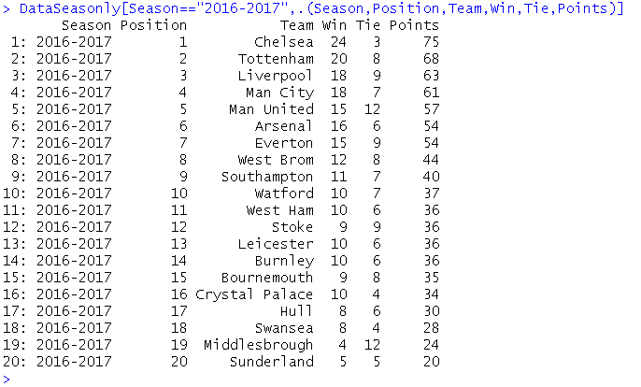
Before we predict
What else can we get from the database?
League tables
(for all years)

Slide 7
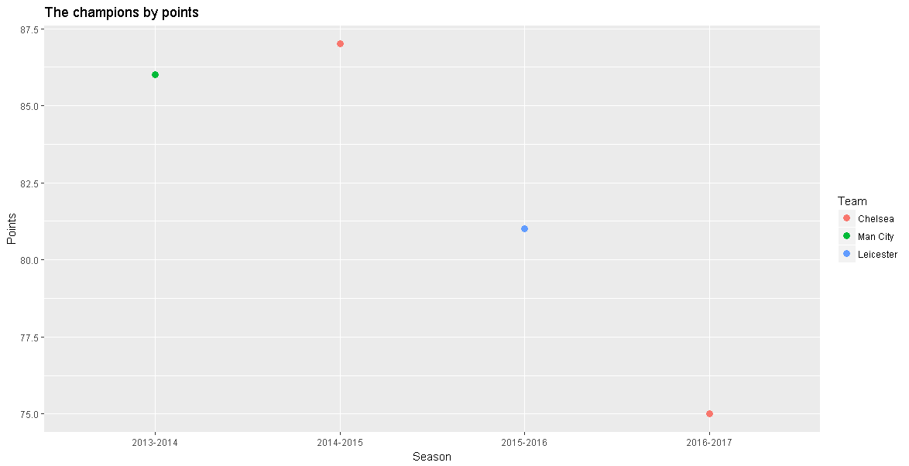
Before we predict
What else can we get from the database?
League tables
(for all years)
General stats

Slide 8
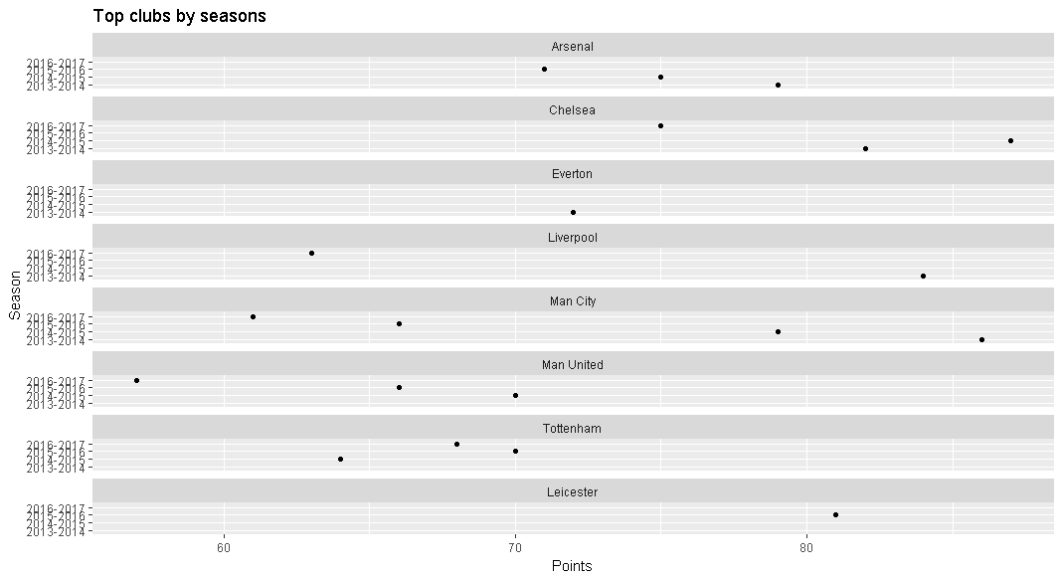
Before we predict
What else can we get from the database?
League tables
(for all years)
General stats
Statistical views
By different
parameters

Slide 9
Predicting football results with Poisson regression

Slide 10
The Poisson distribution
Poisson regression is one of the earliest statistical methods used for predicting football results. The goal here is to use available data to to say something about how many goals a team is expected to score and from that calculate the probabilities for different match outcomes

Slide 11
The Poisson distribution
The Poisson distribution is a probability distribution that can be used to model data that can be counted (i.e something that can happen 0, 1, 2, 3, … times). If we know the number of times something is expected to happen, we can find the probabilities that it happens any number of times. For example if we know something is expected to happen 4 times, we can calculate the probabilities that it happens 0, 1, 2, … times.
It turns out that the number of goals a team scores in a football match are approximately Poisson distributed. This means we have a method of assigning probabilities to the number of goals in a match and from this we can find probabilities for different match results. Note that I write that goals are approximately Poisson. The Poisson distribution does not always perfectly describe the number of goals in a match. It sometimes over or under estimates the number of goals, and some football leagues seems fit the Poisson distribution better than others. Anyway, the Poisson distribution seems to be an OK approximation.

Slide 12
The regression model
To be able to find the probabilities for different number of goals we need to find the expected number of goals L (It is customary to denote the expectation in a Poisson distribution by the Greek letter lambda, This is where the regression method comes in. With regression we can estimate lambda conditioned on certain variables. The most obvious variable to look at is which team is playing. The second thing we want to take into account is who the opponent is. Some teams are expected to concede fewer goals, while others are expected to let in more goals. The third thing we want to take into account is home field advantage.
Written in the language of regression models this becomes
log(lambda) = mu + home + team_{i} + opponent_{j}
The mu is the overall mean number of goals. The home is the effect on number of goals a team has by playing at home. Team_{i} is the effect of team number i, opponent_{j} is the effect of team j.
The logarithm on the left hand side is called the link function. the short story is that they ensure that the parameter we try to estimate don’t fall outside its domain. In this case it ensures us that we never get negative expected number of goals.

Slide 13
Why regression model
PROS
What makes this regression model interesting is that it takes into account both the team and opposition in each game. Fortunately, you don’t have to punch in the data yourself.
When it comes to Poisson regression models for football results, the 1997 paper Modelling Association Football Scores and Inefficiencies in the Football Betting Market (pdf) by Dixon and Coles is often mentioned.
The model by Dixon and Coles is not as easy to fit as the independent Poisson model.

Slide 14
Why regression model
CONS
One major problem to see with the model is that the predictor variables are categorical. This is a constraint that makes inefficient use of the available data since we get rather few data points per parameter.
(Dixon Coles offers Another way the model can be improved is to incorporate a time aspect. The most obvious way to do this is perhaps to weights to the matches such that more recent matches are more important than matches far back in time).

Slide 15
Data
We will use data from football-data.co.uk. Each of the terms on the right hand side of the equation (except for mu) corresponds to a columns in a table, so we need to fix our data a bit before we proceed with fitting the model. Each match is essentially two observations, one for how many goals the home team scores, the second how many the away team scores. Basically, each match need two rows in our data set, not just one.

Slide 16
Simulation
We simulate a number of matches (10000 in our case) by having the computer draw random numbers from the two Poisson distributions and look at the differences. We get the probabilities for the different outcomes by calculating the proportion of different goal differences. The independence assumption makes this easy since we can simulate the number of goals for each team independently of each other.

Slide 17
Match result probabilities
Now that we have our expected number of goals for the two opponents in a match, we can calculate the probabilities for either home win (H), draw (D) and away win (A). But before we continue, there is an assumption in our model that needs to be discussed, namely the assumption that the goals scored by the two teams are independent. This may not be obvious since surely we have included information about who plays against who when we predict the number of goals for each team. But remember that each match is included twice in our data set, and the way the regression method works, each observation are assumed to be independent from the others. this can cause some problems.

Slide 18
Conclusions
Having:
Knowledge that number of goals a team scores in a football match are approximately Poisson distributed
glm() function for generalized linear models provided by R using log link function as Poisson distribution.
Mass amount of database (*)
Led us to seriously considerate the implementation of this model ultimately.
The Poisson regression model is not considered to be among the best models for predicting football results. It is especially poor at predicting draws. Even when the two teams are expected to score the same number of goals it rarely manages to assign the highest probability for a draw.
(*) – which is not typically used if making predictions because of the lack for weighted more/less relevant details.

Slide 19

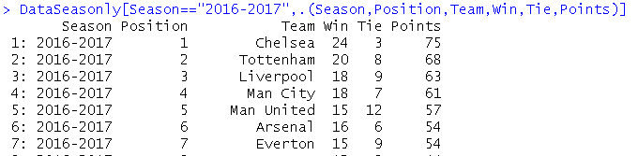
Predictions
In this example, we predict by date > 2014, means all database from season 2014-2015 till now (2016-2017,Week 31) is taking place on the calculations.
We chose to predict who will be the champion of English Premier League,
Having known 31/38 has been played.
We can predict Chelsea and Tottenham next 5 matches results,
Tottenham upcoming 5 fixtures: Bournemouth, Crystal Palace, Arsenal, Westham, Man Utd.
Chelsea upcoming 5 fixtures: Man Utd, Southampton, Everton, Middlesbrough, West Bromwich.

Slide 20
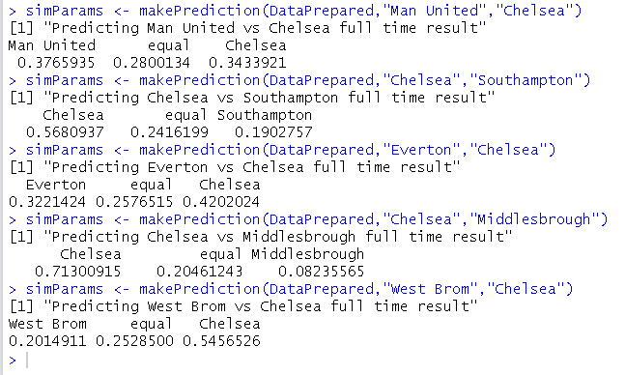

“Only Manchester can stop the Blues.”

Slide 21
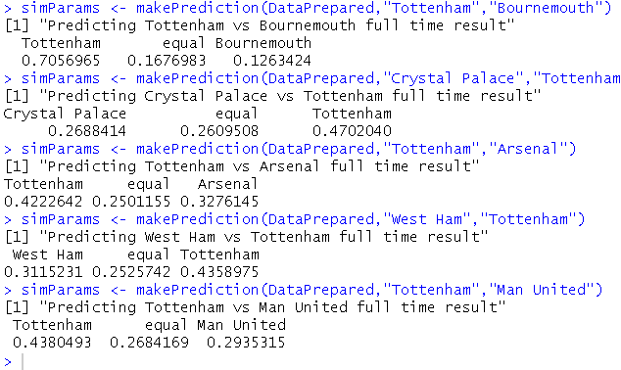

“Too good too late...” - Chelsea celebrates the championship

Slide 22

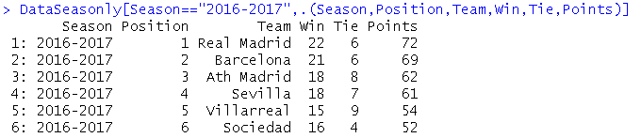
Predictions
In this example, we predict by date > 2014, means all database from season 2014-2015 till now (2016-2017,Week 31) is taking place on the calculations.
We chose to predict who will be the champion of Spanish La Liga,
Having known 31/38 has been played.
We can predict Real Madrid and Barcelona next 5 matches results,
Real Madrid upcoming 5 fixtures: S. Gijon, Barcelona, Deportivo, Valencia, Granada.
Barcelona upcoming 5 fixtures: Sociedad, R.Madrid, Osasuna, Espanol, Villareal.

Slide 23
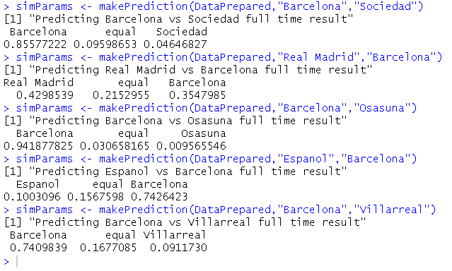
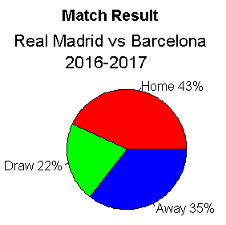
“Bad end for Barcelona...”

Slide 24
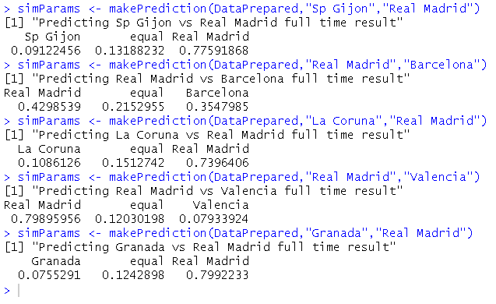

“Real triumph the ‘Classico’.” - and the Championship

Slide 25
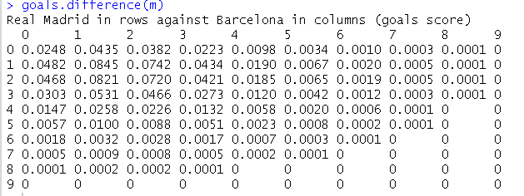

“Real triumph the ‘Classico’.” - and the Championship
We can also predict exact results using goals.difference function:
Most probabilities says Real wins by one goal difference ( probably 2-1 ).

Slide 26

The End

Slide 27
References
http://opisthokonta.net
http://www.football-data.co.uk/data.php
https://www.r-bloggers.com/football-predictions-display/

